Slide 1

Presentation
By group
Sameera A.aziz
Mariam Iqbal
Fouz Alenzi

Slide 2


U.S. National Outbreak Reporting System

Slide 3
U.S. National Outbreaks
“Based on the National Outbreak Reporting System (NORS)”

Slide 4
What do we know about NORS
What is Nors?

Slide 5
“NORS stands for the National Outbreak Reporting System, It collects data about foodborne, waterborne, and other disease outbreaks across the U.S. since 2009.”

Slide 6
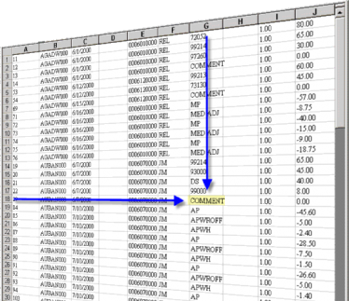
About the Data
We used a real CSV dataset with over 10,000 rows. It includes columns like year, state, number of illnesses, deaths, and more.

Slide 7
Let’s know about the loses

Slide 8
Which regions or states report the most outbreaks?

Slide 9
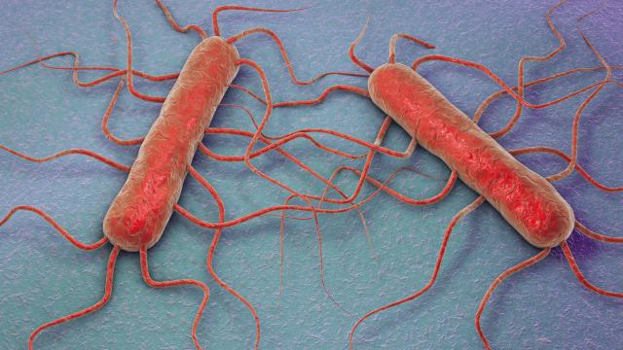
We found that some states like Wisconsin and Pennsylvania reported the highest number of outbreaks.

Slide 10
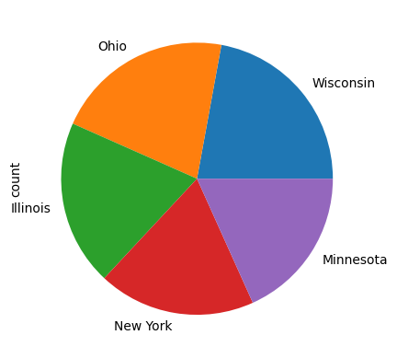

Slide 11
After conducting a detailed analysis, we found that approximately 502,652 people were affected by disease outbreaks in Wisconsin.

Slide 12
After conducting a detailed analysis, we found that approximately 502,652 people were affected by disease outbreaks in Wisconsin
Norovirus
Animal type
Foodborne/waterborne

Slide 13
What are the top causes of foodborne outbreaks?

Slide 14

To find the top causes of foodborne outbreaks, we look at illness reports and group them by what caused the sickness-like a bacteria or a food type. Then we total the number of cases for each and sort to find the most common. This helps prevent future outbreaks by improving food safety policies.

Slide 15
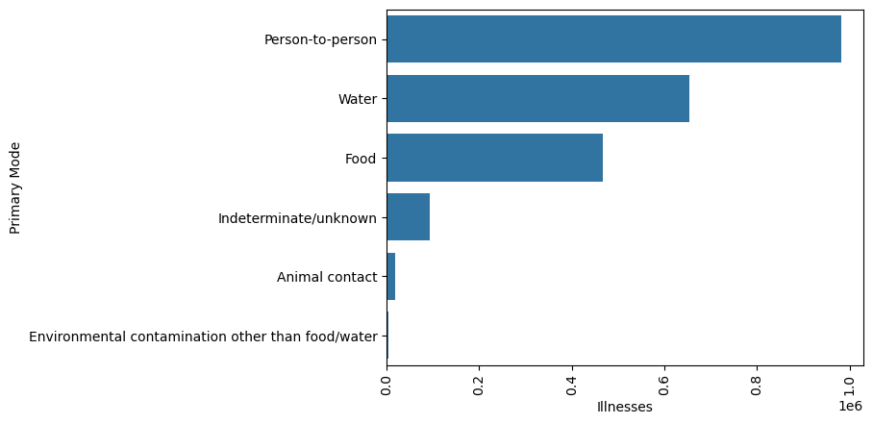

Slide 16
Death In each state?

Slide 17
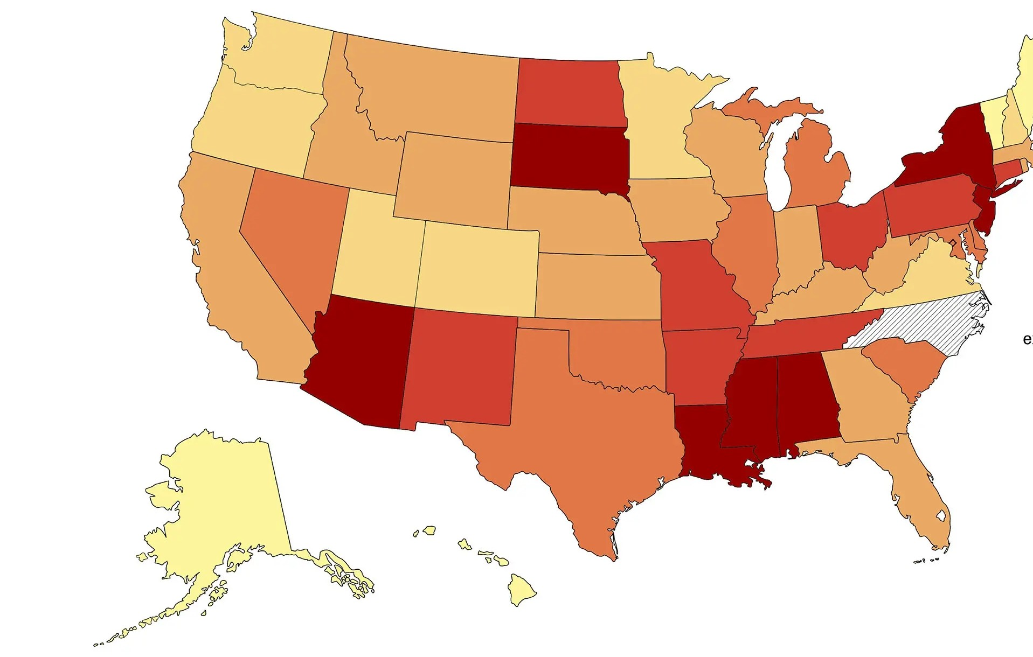
We grouped the data by city and summed the number of deaths. Then we sorted from highest to lowest to find the cities with the greatest impact. This makes it easier to understand where the most serious cases are concentrated.

Slide 18
